Slide 1


Welcome to Mehndi Management App
Mehndi Management App is a powerful tool designed to help mehndi artists, enthusiasts, and businesses streamline their mehndi design management. With a user-friendly interface and seamless integration with a PostgreSQL database, this app empowers users to effortlessly create, organize, and maintain a comprehensive collection of mehndi designs.
by Maya

Slide 2
Login Interface
Secure Authentication
Intuitive Design
Secure Data Storage
The login interface of the Mehndi Management App employs a robust authentication system to ensure the privacy and security of user accounts. Users can log in with their predefined credentials, granting them access to the app's powerful features and functionalities.
The login screen boasts a clean, minimalist design with elegant mehndi pattern accents, providing a visually appealing and user-friendly experience. The dark mode option adds a touch of sophistication to the interface, ensuring a comfortable viewing experience even in low-light conditions.
By integrating with a PostgreSQL database, the Mehndi Management App ensures that all user data, including login credentials and mehndi designs, are securely stored and protected, giving users peace of mind and confidence in the app's reliability.

Slide 3




Authentication Process
User Input
The user enters their predefined login credentials, including a username and password, to initiate the authentication process.
Credential Validation
The app's secure authentication system verifies the user's credentials against the stored data in the PostgreSQL database, ensuring the legitimacy of the login attempt.
Successful Login
Upon successful validation, the user is granted access to the Mehndi Management App's main interface, unlocking the full range of features and functionalities.

Slide 4

Successful Login
1
Welcome Message
2
Intuitive Navigation
After a successful login, the user is greeted with a warm welcome message, setting the tone for a pleasant and productive user experience within the Mehndi Management App.
The main interface features an intuitive and user-friendly navigation system, allowing users to seamlessly access various functionalities, such as managing mehndi design categories and creating, viewing, and deleting mehndi designs.
3
Elegant Aesthetic
The dashboard of the Mehndi Management App boasts an elegant and visually appealing design, with intricate mehndi patterns and a warm, inviting color palette that creates a calming and inspiring atmosphere for users.

Slide 5
Main Interface Overview
Category Management
Mehndi Design Management
Database Connectivity
The main interface of the Mehndi Management App includes a comprehensive category management system, allowing users to create, view, and delete mehndi design categories stored in the CategoriesMehndi table of the PostgreSQL database.
Underpinning the Mehndi Management App's functionality is its seamless integration with a PostgreSQL database, allowing for the secure storage and retrieval of all mehndi design data.
The main interface also provides users with the ability to create, view, and delete individual mehndi designs, ensuring a comprehensive and organized collection of artistic creations.
Reliable data storage and management
Add new mehndi designs
Organize designs by category
Examine and explore existing designs
Efficient querying and data manipulation
Add new design categories
Modify or delete existing categories
Remove outdated or unwanted designs
Scalable and secure database solution

Slide 6




Connecting to PostgreSQL Database
Database Integration
Secure Communication
Efficient Data Management
Scalable Solution
The PostgreSQL database provides a scalable and reliable platform to accommodate the growing needs of the Mehndi Management App, allowing for the storage and management of an ever-expanding collection of mehndi designs.
The Mehndi Management App seamlessly integrates with a PostgreSQL database, enabling the storage and retrieval of mehndi design data, ensuring the app's functionality and reliability.
The app employs secure communication protocols to establish a reliable and encrypted connection with the PostgreSQL database, safeguarding the integrity and confidentiality of all user data.
Through the database integration, the Mehndi Management App can seamlessly retrieve, update, and store mehndi design data, ensuring a smooth and efficient user experience.

Slide 7
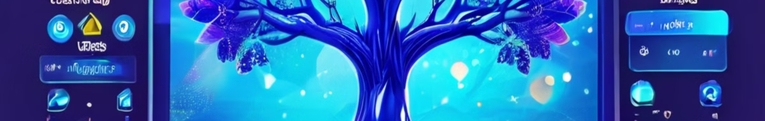
Managing Mehndi Design Categories
View Design Categories
1
Users can easily navigate and view the existing mehndi design categories stored in the CategoriesMehndi table of the PostgreSQL database, displayed in a treeview format within the app's interface.
2
Add New Categories
The app provides an intuitive interface for users to create new mehndi design categories, allowing them to organize their growing collection of artistic creations in a structured and meaningful manner.
Modify or Delete Categories
3
If needed, users can also easily edit or remove existing mehndi design categories, ensuring the category hierarchy remains up-to-date and relevant to their needs.

Slide 8
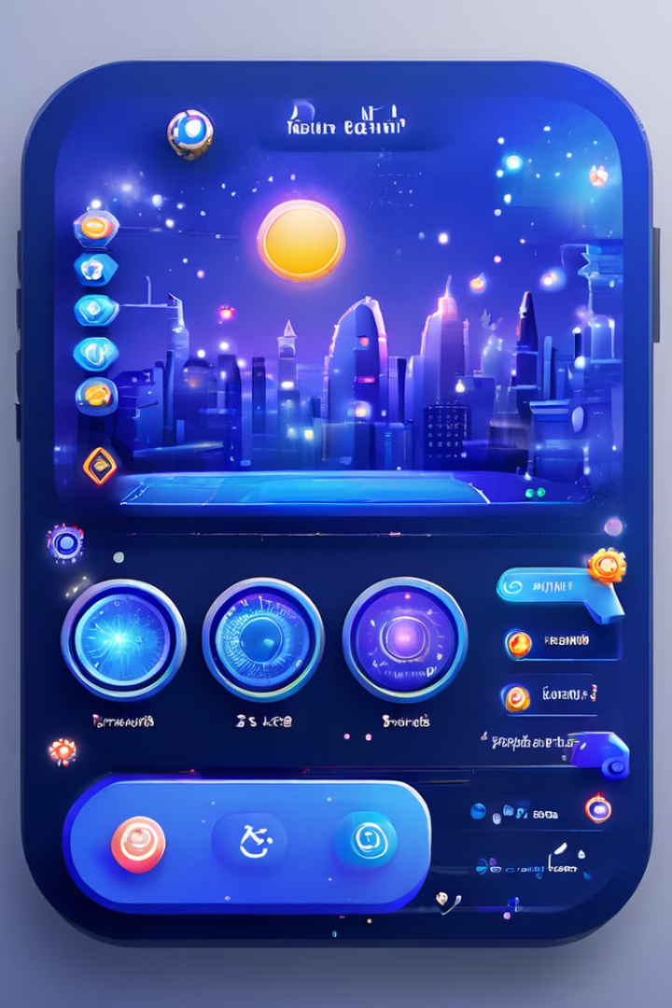
Creating, Viewing, and Deleting Designs
Create New Designs
Users can add new mehndi designs to the app's database, providing details such as the design's name, category, and any relevant notes or descriptions.
View Existing Designs
The app allows users to explore and examine their collection of mehndi designs, providing a comprehensive view of the stored designs and their associated details.
Delete Unwanted Designs
If needed, users can easily remove outdated or unwanted mehndi designs from the app's database, ensuring their collection remains organized and up-to-date.

Slide 9

Conclusion and Next Steps
The Mehndi Management App is a powerful and versatile tool that empowers mehndi artists, enthusiasts, and businesses to streamline their design management processes. With its intuitive interface, seamless PostgreSQL integration, and comprehensive design management capabilities, users can now effortlessly organize, access, and maintain their mehndi design collections.
As the app continues to evolve, future updates may include features such as design sharing, collaborative workspaces, and advanced analytics, further enhancing the user experience and unlocking new possibilities for the mehndi design community.

